Slide 1
Organic Chemistry

Slide 2
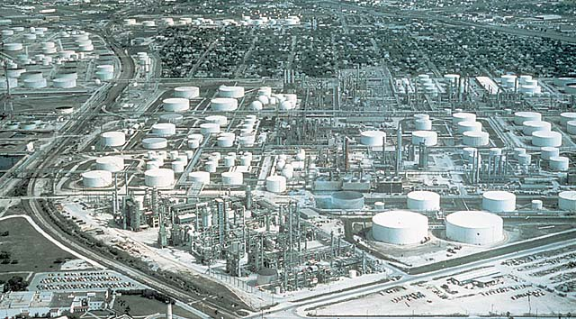
Refinery and tank storage facilities, like this one in Texas, are needed to change the hydrocarbons of crude oil to many different petroleum products. The classes and properties of hydrocarbons form one topic of study in organic chemistry.

Slide 3
Organic Compounds

Slide 4
An organic compound is one that has carbon as the principal element
An inorganic element is any compound that is not an organic compound.
Carbon is unique
  It has 6 electrons in its outer shell arranges 1s²2s²sp²
  It has room for 4 bonds to 4 other atoms.
Organic compounds have specific geometry around the carbon to carbon bond.
  If there are four atoms or groups around a carbon atom, it has a tetrahedral geometry.

Slide 5
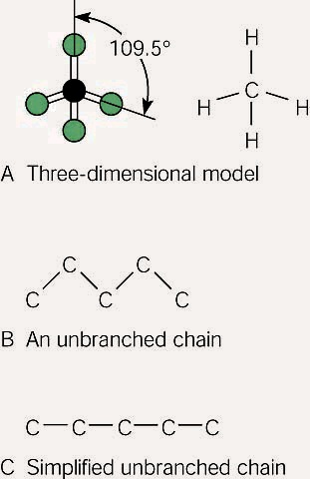
(A)The carbon atom forms bonds in a tetrahedral structure with a bond angle of 109.5^{O}. (B) Carbon-to-carbon bond angles are 109.5^{O}, so a chain of carbon atoms makes a zigzag pattern. (C) The unbranched chain of carbon atoms is usually simplified in a way that looks like a straight chain, but it is actually a zigzag, as shown in (B).

Slide 6
Hydrocarbons

Slide 7
Introduction
  A hydrocarbon is a compound consisting of only hydrogen and carbon.
  The carbon to carbon can be single, double, or triple bonds.
  The bonds are always nonpolar.
  Alkanes are hydrocarbons with only single bonds.
    Alkanes occur in what is called a homologous series.
    Each successive compound differs from the one before it only by a CH₂

Slide 8
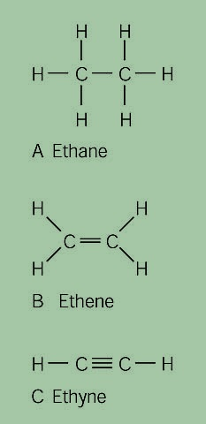
Carbon-to-carbon bonds can be single (A), double (B), or triple (C). Note that in each example, each carbon atom has four dashes, which represent four bonding pairs of electrons, satisfying the octet rule.

Slide 9
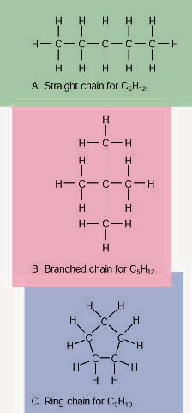
Carbon-to-carbon chains can be (A) straight, (B) branched, or (C) in a closed ring. (Some carbon bonds are drawn longer, but are actually the same length.)

Slide 10
  Compounds that have the same molecular formula, but different structures (arrangements of the atoms) are called isomers.
  Naming alkanes
    Identify the longest continuous chain.
    The locations or other groups of atoms attached to the longest chain are identified and numbered by counting from the end of the molecule which keeps the numbering system as low as possible.
    Hydrocarbon groups that are attached to the longest continuous chain and named using the parent name and changing the –ane suffix to –yl.

Slide 11
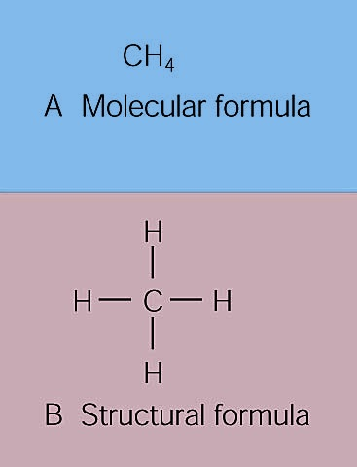
Recall that a molecular formula (A) describes the numbers of different kinds of atoms in a molecule, and a structural formula (B) represents a two-dimensional model of how the atoms are bonded to each other. Each dash represents a bonding pair of electrons.

Slide 12
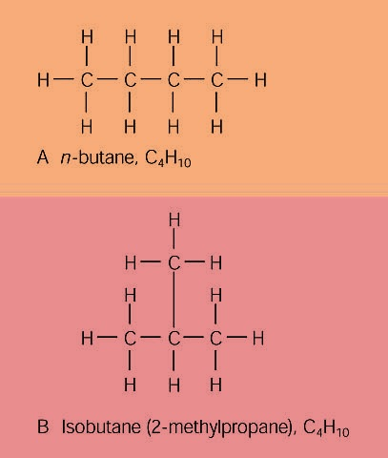
(A)A straight-chain alkane is identified by the prefix n- for "normal" in the common naming system. (B) A branched-chain alkane isomer is identified by the prefix iso- for "isomer" in the common naming system. In the IUPAC name, isobutane is 2-methylpropane. (Carbon bonds are actually the same length.)

Slide 13
Alkenes and Alkynes
  Alkenes are hydrocarbons with at least one double carbon to carbon bond.
    To show the presence of the double bond, the –ane suffix from the alkane name is changed to –ene.
  The alkenes are unsaturated with respect to hydrogen
    This means it does not have the maximum number of hydrogen atoms as it would if it were an alkane (a saturated hydrocarbon).

Slide 14
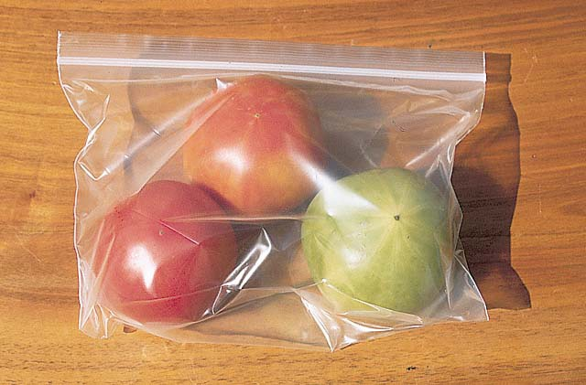
Ethylene is the gas that ripens fruit, and a ripe fruit emits the gas, which will act on unripe fruit. Thus, a ripe tomato placed in a sealed bag with green tomatoes will help ripen them.

Slide 15
  Naming is similar to naming alkanes except:
    The longest continuous chain must contain the double bond.
    The base name now ends in –ene.
    The carbons are numbered so as to keep the number for the double bond as low as possible.
    The base name is given a number which identifies the location of the double bond.
  An alkyne is a hydrocarbon with at least one carbon to carbon triple bond.
  Naming an alkyne is similar to the alkenes, except the base name ends in –yne.

Slide 16
Cycloalkanes and Aromatic Hydrocarbons
  Cycloalkanes are alkanes (only carbon to carbon single bonds) which form a ring structure.
  An aromatic compound is one that is based on the benzene ring.
  A benzene ring that is attached to another compound is given the name phenyl.

Slide 17
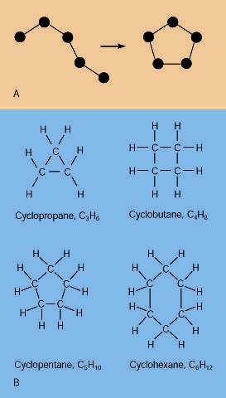
(A)The "straight" chain has carbon atoms that are able to rotate freely around their single bonds, sometimes linking up in a closed ring. (B) Ring compounds of the first four cycloalkanes.

Slide 18
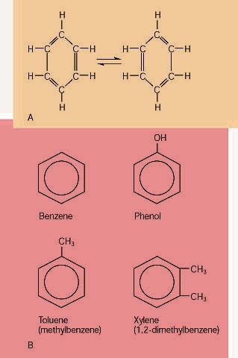
(A)The bonds in C₆H₆ are something between single and double, which gives it different chemical properties than double-bonded hydrocarbons. (B) The six-sided symbol with a circle represents the benzene ring. Organic compounds based on the benzene ring are called aromatic hydrocarbons because of their aromatic character.

Slide 19
Petroleum

Slide 20
Petroleum is a mixture of alkanes, cycloalkanes, and aromatic hydrocarbons.
  Petroleum is formed from the slow decomposition of buried marine life, primarily plankton and algae.
As petroleum is formed it is forced through porous rock until it reaches an impervious layer of rock.
  Here it forms an accumulation of petroleum and saturated the porous rock creating an oil field.

Slide 21
Petroleum was once used for medicinal purposes.
  It was first distilled by running through a whiskey still, in an attempt to make it taste better.
  The liquid that he obtained burned quite well in lamps.
  This clear liquid that was obtained from petroleum distillation was called kerosene.

Slide 22
Crude oil is the petroleum that is pumped directly from the ground.
  It is a complex mixture of hydrocarbons with one or two carbon atoms up to a limit of about 50 carbon atoms.
  This is usually not useful, so it must separated by distillation.

Slide 23
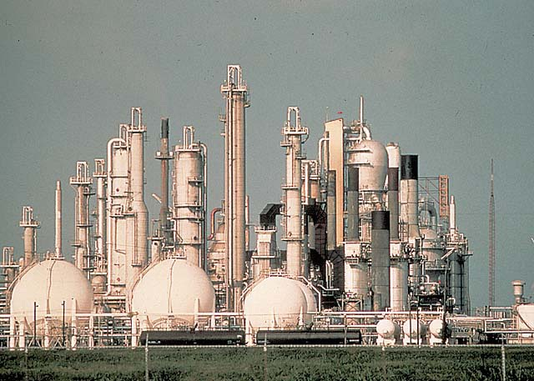
Crude oil from the ground is separated into usable groups of hydrocarbons at this Louisiana refinery. Each petroleum product has a boiling point range, or "cut," of distilled vapors that collect in condensing towers.

Slide 24
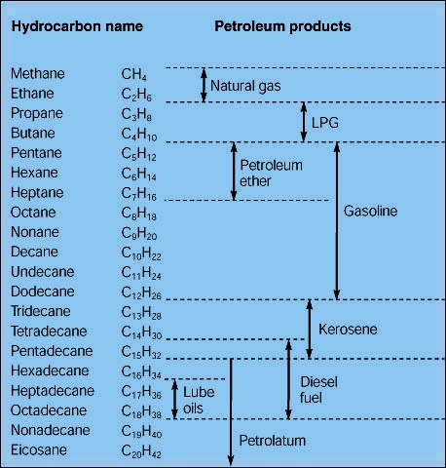
Petroleum products and the ranges of hydrocarbons in each product.

Slide 25
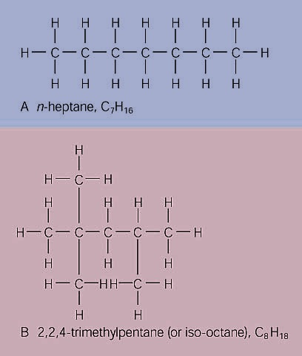
The octane rating scale is a description of how rapidly gasoline burns. It is based on (A) n-heptane, with an assigned octane number of 0, and (B) 2,2,4-trimethylpentane, with an assigned number of 100.

Slide 26
Hydrocarbon Derivatives

Slide 27
Introduction
  Hydrocarbon derivatives are formed when one or more hydrogen atoms is replaced by an element or a group of elements other than hydrogen.
  Halogens (F₂, Cl₂, Br₂, I₂,) can all add to a hydrocarbon to form am alkyl halide.
    When naming the halogen the –ine ending is replaced by –o
    Fluorine becomes fluoro
    Chlorine becomes chloro
    Bromine becomes bromo
    Iodine becomes iodo

Slide 28
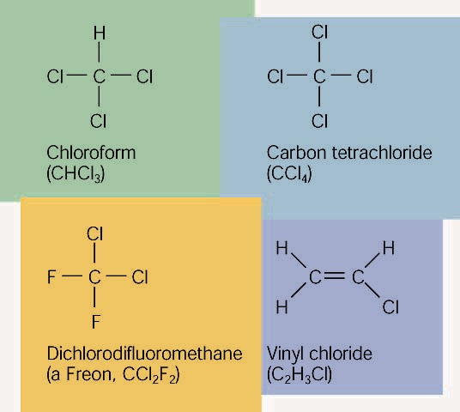
Common examples of organic halides.

Slide 29
  Alkenes can also add to each other in an addition reaction to form long chains of carbon compounds.
    this is called polymerization
  The atom or group of atoms that are added to the hydrocarbon are called functional groups.
    Functional groups usually have multiple bonds or lone pairs of electrons that make them very reactive.

Slide 30
Alcohols
  An alcohol has a hydrogen replaced by a hydroxyl (-OH) group.
  The name of the hydrocarbon that was substituted determines the name of the alcohol.
  The alcohol is named using the hydrocarbon name and adding the suffix –ol.
    If methane is substituted with an OH group it becomes methanol
    If a pentane group is substituted with an OH group it is pentanol.
    For alcohols with more than two carbon atoms we need the number the chain so as to keep the alcohol group as low as possible.

Slide 31
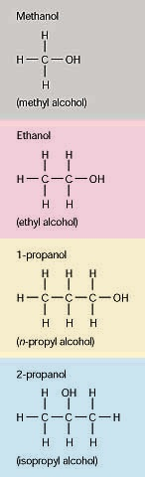
Four different alcohols. The IUPAC name is given above each structural formula, and the common name is given below.

Slide 32
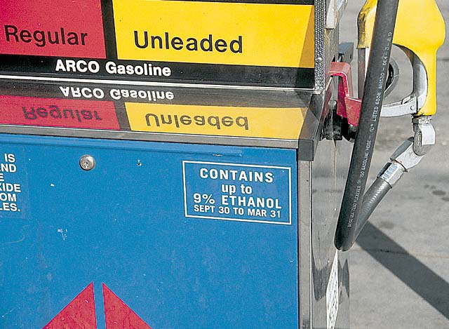
Gasoline is a mixture of hydrocarbons (C₈H₁₈ for example) that contain no atoms of oxygen. Gasohol contains ethyl alcohol, C₂H₅OH, which does contain oxygen. The addition of alcohol to gasoline, therefore, adds oxygen to the fuel. Since carbon monoxide forms when there is an insufficient supply of oxygen, the addition of alcohol to gasoline helps cut down on carbon monoxide emissions. An atmospheric inversion, with increased air pollution, is likely during the dates shown on the pump, so that is when the ethanol is added.

Slide 33
  The OH group is polar and short chain alcohols are soluble in both nonpolar alkanes and water.
  If an alcohol contains two OH groups it is a diol (sometimes called a glycol).
  An alcohol with three OH groups is called a triol (sometimes called a glycerol).

Slide 34
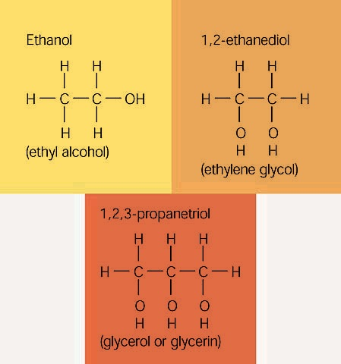
Common examples of alcohols with one, two, and three hydroxyl groups per molecule. The IUPAC name is given above each structural formula, and the common name is given below.

Slide 35
Ethers, Aldehydes, and Ketones
  An ether has a general formula ROR’
    Diethyl ether for example would have the formula CH₃CH₂OCH₂CH₃
  An aldehyde has a carbonyl group (carbon double bonded to an oxygen) attached to a terminal carbon atom
  A ketone has a carbonyl group attached to an internal carbon atom.

Slide 36
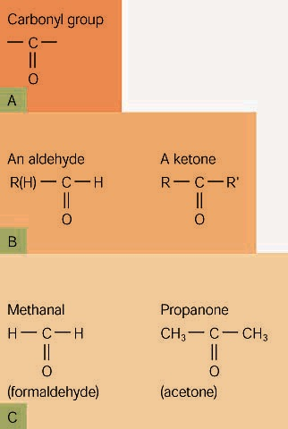
The carbonyl group (A) is present in both aldehydes and ketones, as shown in (B). (C) The simplest example of each, with the IUPAC name above and the common name below each formula.

Slide 37
Organic Acids and Esters
  Organic acids are those acids that are derived from living organisms, usually from metabolism, but sometimes as a defense mechanism.
  Long chain organic acids are known as fatty acids.
  These are also called carboxylic acids as they contain the carboxyl functional group (COOH)
    One oxygen is double bonded to the carbon and the other is bonded to the carbon and to the hydrogen both with single bonds.
  Esters are condensation products of carboxylic acids with the removal of water (also called a dehydration synthesis).

Slide 38
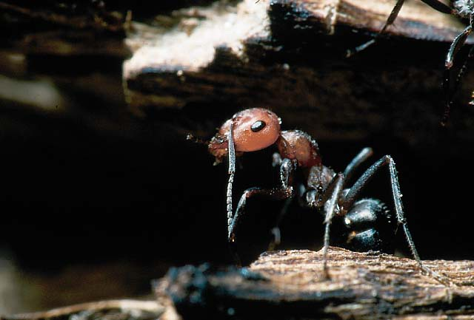
These red ants, like other ants, make the simplest of the organic acids, formic acid. The sting of bees, ants, and some plants contains formic acid, along with some other irritating materials. Formic acid is HCOOH.

Slide 39
Organic Compounds of Life

Slide 40
Introduction
  Living organisms have to be able to:
    Exchange matter and energy with their surroundings.
    Transform matter and energy into different forms.
    Respond to changes in their environment.
    Grow.
    Reproduce.

Slide 41
  All of these changes are due to large organic compounds called macromolecules.
    A macromolecule is a combination of many smaller similar molecules polymerized into a chain structure.
  In living organisms there are three main types of macromolecules which control all activities and determine what an organism will do and become.
    Proteins.
    Carbohydrates
    Nucleic acids.

Slide 42
  The basic unit of life is the cell.
    The cell makes up all living organisms that we know of.
    Cells are in turn made of macromolecules that form inside the cell.
    Other macromolecules control the formation of these macromolecules.
  Metabolism is the breaking down or building up of macromolecules.
    Generally, breaking down macromolecules releases energy that the organism can use as an energy source.
    The building up of macromolecules requires energy, that is obtained from breaking down macromolecules.

Slide 43
Proteins
  Proteins are macromolecules that are polymers of amino acids.
  Structurally, proteins go into making muscle tissue, connective tissue, and skin, hair, and nails, just to name a few.
  Functionally proteins are enzymes which catalyze biochemical reactions
    Building up macromolecules requires energy and an enzyme lowers the amount of energy that is necessary.

Slide 44
  There are 20 amino acids that go into producing proteins.
    These amino acids are polymerized by a dehydration synthesis to form long chains of repeating amino acids called a protein.
    The arrangement of the amino acids in the polymer determine the structure of the protein which confers to it is function or structural attributes.

Slide 45
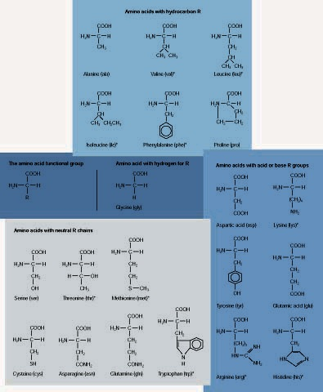
The twenty amino acids that make up proteins, with three-letter abbreviations. The carboxyl group of one amino acid bonds with the amino group of a second acid to yield a dipeptide and water. Proteins are polypeptides.

Slide 46
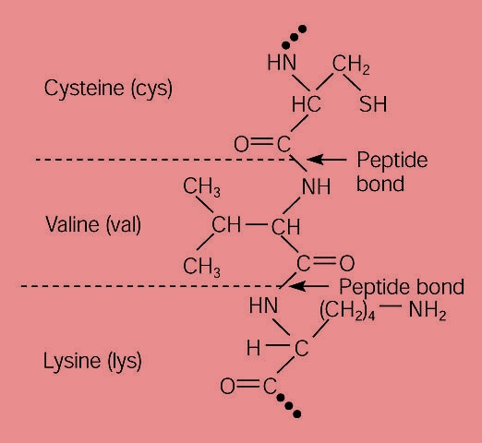
Part of a protein polypeptide made up of the amino acids cysteine (cys), valine (val), and lysine (lys). A protein can have from fifty to one thousand of these amino acid units; each protein has its own unique sequence.

Slide 47
Carbohydrates
  Carbohydrates are a large group of compounds that are generally called sugars, starches, and cellulose (all of which are sugars or polymers of sugars)
  Generally sugars are a storage source of energy.
    By breaking sugars down into carbon dioxide and water, living organisms can release the energy that is locked up in them to use for energy requirements.
  Glucose is the carbohydrate that animals utilize mostly for their energy.

Slide 48
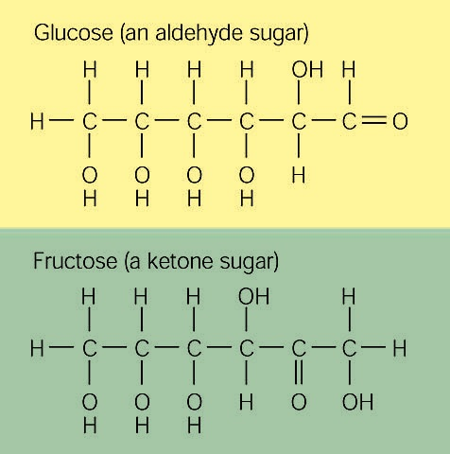
Glucose (blood sugar) is an aldehyde, and fructose (fruit sugar) is a ketone. Both have a molecular formula of C₆H₁₂O₆

Slide 49
  Classification
    A monosaccharide is one that is made up of just one sugar unit.
    A disaccharide is one that is made up of two sugar units.
    A polysaccharide is one that is made up of many sugar units.

Slide 50
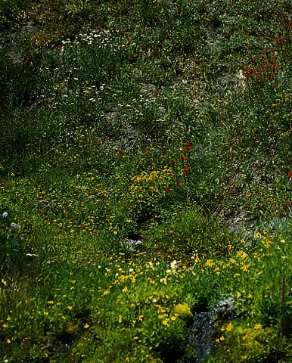
These plants and their flowers are made up of a mixture of carbohydrates that were manufactured from carbon dioxide and water, with the energy of sunlight. The simplest of the carbohydrates are the monosaccharides, simple sugars (fruit sugar) that the plant synthesizes. Food is stored as starches, which are polysaccharides made from the simpler monosaccharides. The plant structure is held upright by fibers of cellulose, another form of a polysaccharide.

Slide 51
  Starch is a storage carbohydrate used by plants.
    When plants photosynthesize the use the energy from sunlight to convert carbon dioxide and water into sugars and oxygen.
  Glycogen is a storage carbohydrate used by animals.
  Cellulose is a polysaccharide that is used in plant cell walls to maintain their structure.

Slide 52
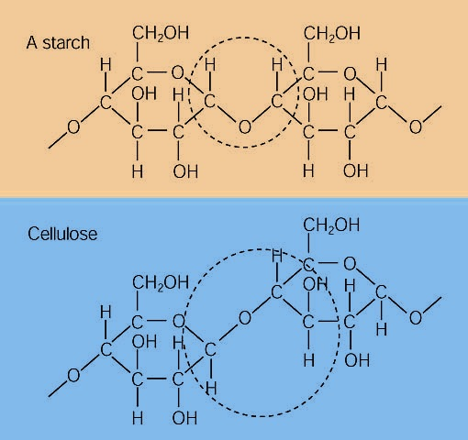
Starch and cellulose are both polymers of glucose, but humans cannot digest cellulose. The difference in the bonding arrangement might seem minor, but enzymes must fit a molecule very precisely. Thus, enzymes that break down starch do nothing to cellulose.

Slide 53
Fats and Oils
  Humans take in amino acids and utilize them to synthesize the polymers that are called proteins.
    There are 10 amino acids which humans cannot synthesize themselves and must be in the diet, these are called essential amino acids.
  Humans also take in carbohydrates and use the break down of the carbohydrate as an energy source.
  When either of these is taken in in quantities above that that is necessary for the body, they are converted into fats in animals and oils in plants.
    Fats and oils are a long term storage for energy sources.

Slide 54
  Animal fats are wither saturated or unsaturated, but most are saturated.
    Unsaturated fats are believed to lower cholesterol levels in humans.
    Saturated fats and cholesterol are thought to contribute to hardening of the arteries.
  Fats are stored in adipose tissue which has an insulating function, a padding (protective) function, as well as a storage function.

Slide 55
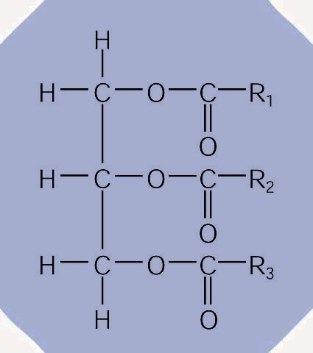
The triglyceride structure of fats and oils. Note the glycerol structure on the left and the ester structure on the right. Also notice that R1, R2, and R3 are long-chained molecules of 12, 14, 16, 18, 20, 22, or 24 carbons that might be saturated or unsaturated.

Slide 56
Synthetic Polymers

Slide 57
Polymers
  Polymers are long molecules with repeating structures of simpler molecules.

Slide 58
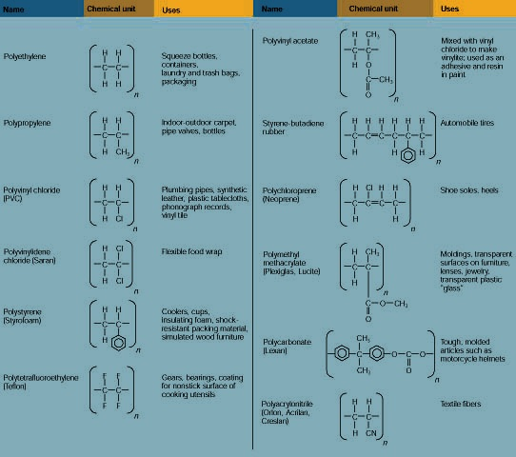
Synthetic polymers, the polymer unit, and some uses of each polymer.

Slide 59
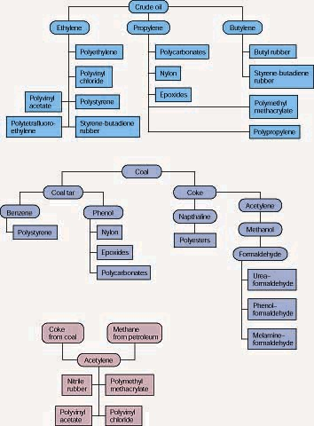
Petroleum and coal as sources of raw materials for manufacturing synthetic polymers.

Slide 60
This powerpoint was kindly donated to www.worldofteaching.com
http://www.worldofteaching.com is home to over a thousand powerpoints submitted by teachers. This is a completely free site and requires no registration. Please visit and I hope it will help in your teaching.

